Slide 1
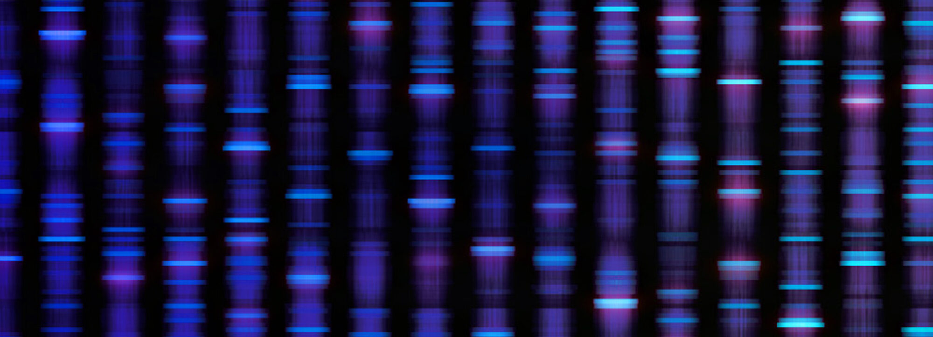
My genomic variants associated with
Atopic Dermatitis
Brandon Hancock
Notes:
Image https://researchinschools.org/projects/genome-decoders/

Slide 2


Nebula Genomics
Given the scattered history of inflammatory skin problems in the families of 3 of my grandparents, I’ve been interested in the genetic basis of atopic dermatitis for some time
Lo and behold, Nebula Genomics has recently lowered their price for 30x whole genome sequencing (currently priced at 299$), thank you George Church!

Slide 3
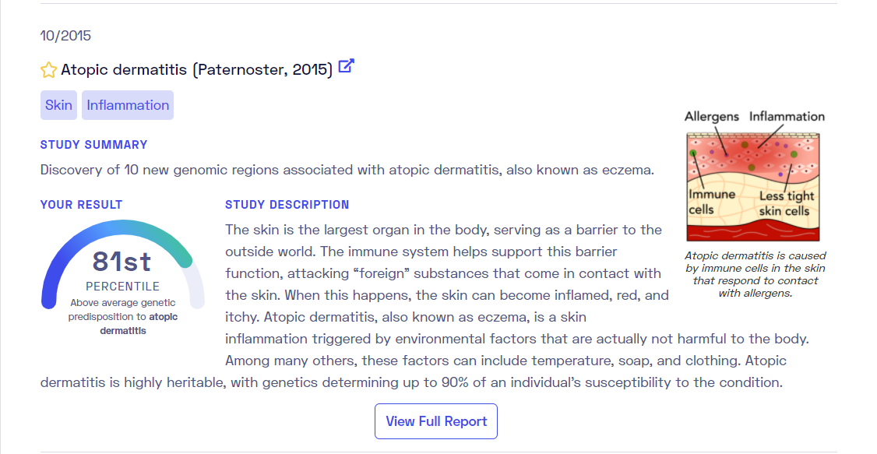
Nebula Library Report
The service provides many basic reports like the one below, and includes the variants (next slide) they used to calculate predisposition percentile

Slide 4
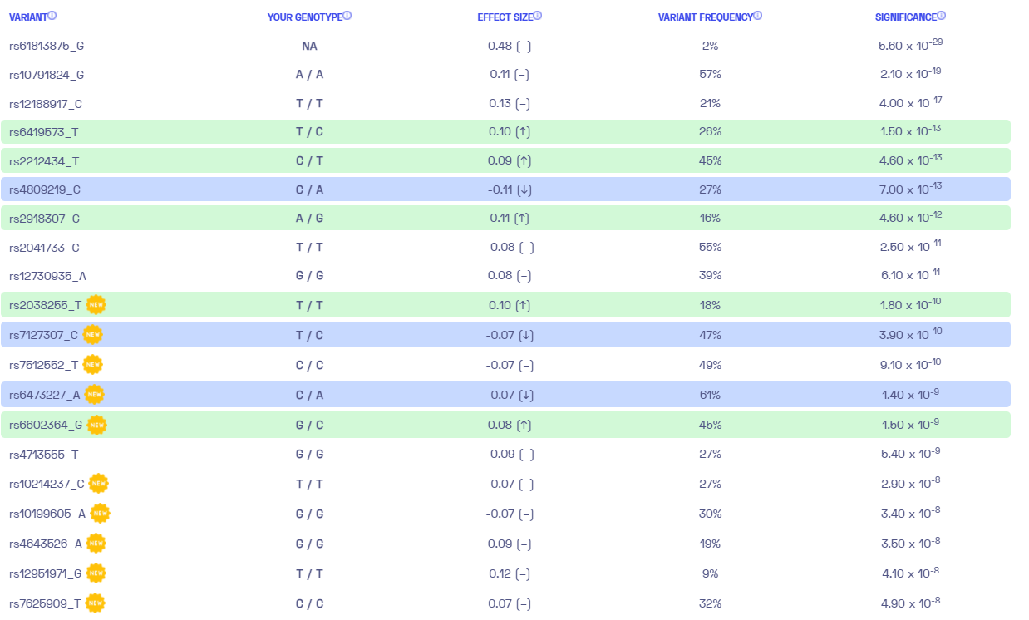
Variant report

Slide 5

Raw data
Nebula also provides raw data so that users can do their own analysis. I used my VCF file to identify locations where my genome differed from the reference

Slide 6
My variants associated with AD
Variant ID | Position | Effect allele | My genotype | Gene or closest genes | Paper | Slides
rs192116923 | 1:152306930 | G | G/G | FLG | 7 | 8-11
rs4852714 | 2:70852115 | A | A/A | CD207 | 1 | 12-13
rs13015714 | 2:102355405 | G | G/T | IL1RL1/IL18RAP | 5 | 14
rs6419573 | 2:102410643 | C | C/T | IL18R1/IL18RAP | 1 | 14
rs3755267 | 2:102422127 | NA | G/T | IL18R1/IL18RAP | 1 | 14
rs6780220 | 3:33045708 | C | A/C | GLB1 | 5 | NA
rs12634229 | 3:112657461 | C | C/T | CCDC80/CD200R1L | 5 | 15
rs1249910 | 3:112672327 | A | A/G | CCDC80/CD200R1L | 1 | 15
rs2897442 | 5:132713335 | C | C/T | KIF3A | 3 | 16
rs176095 | 6:32190542 | A | A/G | GPSM3 | 5 | 17

Slide 7
My variants associated with AD II
Variant ID | Position | Effect allele | My genotype | Gene or closest genes | Paper | Slides
rs4722404 | 7:3089155 | C | C/T | CARD11 | 5 | 18
rs6602364 | 10:6038853 | C | C/G | IL15RA/IL2RA | 1 | NA
rs10995251 | 10:62638706 | C | C/T | ZNF365 | 5 | NA
rs4312054 | 11:7955614 | G | G/G | OR10A3/NLRP10 | 1 | 21
rs2212434 | 11:76570549 | T | C/T | C11orf30/LRRC32 | 2 | 22
rs2038255 | 14:35089920 | T | T/T | PPP2R3C | 1 | NA
rs16948048 | 17:49363104 | G | A/G | ZNF652 | 4 | NA
rs2164983 | 19:8679120 | A | A/C | ADAMTS10/ACTL9 | 3 | NA
rs2918307 | 19:8679458 | G | A/G | ADAMTS10/ACTL9 | 3 | NA
rs6010620 | 20:63678486 | G | A/G | RTEL1 | 6 | NA

Slide 8
Filaggrin Mutation
The Nebula report on atopic dermatitis omitted many of the possible pathogenic variants mentioned in the paper it referenced¹, including all but 1 filaggrin mutation. I wanted to check for those first, as frameshift and early stop mutations in filaggrin are the strongest known risk factors for AD⁸
Of my 6 filaggrin variants, none are frameshift or early stop mutations; but one does have evidence of being pathogenic, rs192116923 T>G, for which I am homozygous
This variant has recently been found to be associated with eosinophilic asthma patients with atopic dermatitis⁷
I actually do occasionally have minor asthma at night (never properly diagnosed)
Night time asthma is a common phenomenon shown to be linked to both circadian rhythms and the action of sleep⁹

Slide 9
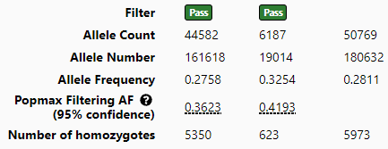
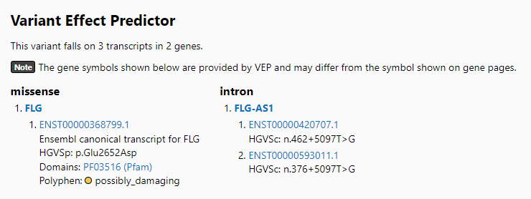
rs192116923
Missense mutation p. Glu 2652 Asp
Allele Frequency 0.2811 (I was surprised as how common this is) https://gnomad.broadinstitute.org/variant/1-152279406-T-G?dataset=gnomad_r2_1

Slide 10
Mechanism of disease?
Gao et al. (2021)⁷ point out that HaploReg v4.1 predicts that rs192116923-T mutation to -G can modify its binding motif to Smad3
They suggest a possible mechanism: the variant “may increase the binding of Smad3 to transmit TGF-β1 signaling, and thereby inhibit filaggrin expression”⁷
Gao et al. (2021) point to evidence from Elias et al. (2019), saying that “recent evidence indicated that TGF-β1 could decrease filaggrin protein expression in the late stage of epidermal differentiation”
Honestly to me, this is a questionable interpretation of Elias et al. (2019), who found that in skin organoids, FLG knockouts had less TGF-β1¹⁰
Still, TGF-β1 seems to be relevant

Slide 11
TGF-β1 … does a lot
The TGF-β superfamily is ancient, predating bilateral symmetry in animals. In fact, the TGF-β family itself is linked to the rise of bilateral symmetry. TGF-βs help developing embryos form their body plans⁶
TGF-β signaling has been shown to effect damaged tissue repair, extracellular matrix (ECM) maintenance, epithelial and endothelial cell growth, and differentiation to the regulation of immune responses¹¹
Its role in inflammation is complex and paradoxical; it attracts innate immune cells, hinders naïve T-cell activation, yet promotes Th17 cell activation¹¹
AD is associated with a low TGF-β1 producing genotype¹², while over expression of TGF-1 has been implicated in psoriasis¹³

Slide 12
CD207(Langerin)
Langerin is a carbohydrate binding receptor on langerhans cells(LCs)
LCs are tissue resident macrophages of the skin and mucosal surfaces, and are believed to function as immune sentinels
LCs constantly extend and retract dendrites between keratinocytes, to sense their local environment
They have several known functions¹⁹
Antigen presenting, migrating to skin draining lymph nodes to prime T-cells - demonstrated in epicutaneous yeast and bacterial infection models
Scavenger functions, clearing debris from dying cells
Implicated in fighting viruses

Slide 13
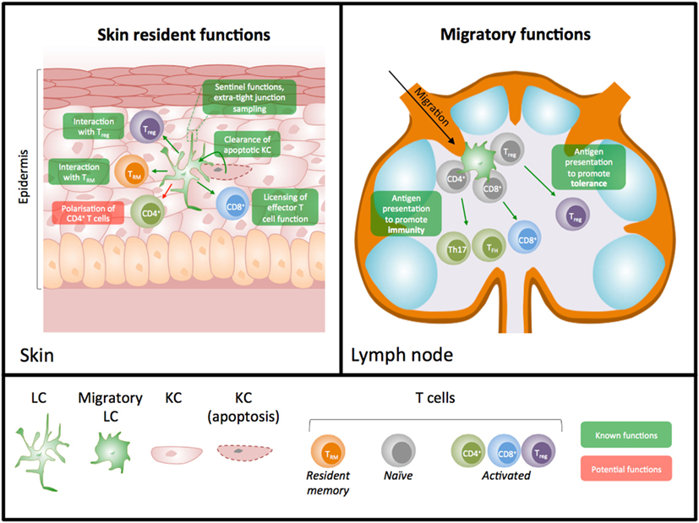
West HC, Bennett CL. Redefining the Role of Langerhans Cells As Immune Regulators within the Skin. Front Immunol. 2018;8:1941. Published 2018 Jan 5. doi:10.3389/fimmu.2017.01941

Slide 14
2q12.1 - IL1RL1/IL18R1/IL18RAP
Variants in this locus are also associated with asthma¹⁴, allergic sensitization¹⁵, self reported allergy¹⁶, and celiac disease¹⁷
There are 80 credible SNPs at this locus¹, associated with AD, I have only checked for the few with the strongest effects (ones mentioned in the text of papers), have many more to check for
According the supplemental notes¹, rs3755267 is in a region that binds several TFs according to ENCODE data, this variant is also associated with expression of IL18R1 in the MuTHER skin expression data¹⁸
To do: study both the ENCODE and MuTHER datasets further, get a better grasp of how this data was collected
I didn’t come across any literature proposing possible start to end mechanisms of action for these mutations in the pathogenesis of AD, just lots of emphasis that the mutations are immune related in GWAS papers

Slide 15
Locus 3q13.2 - CCDC80 and CD100R1L
Variants in this locus are believed to affect transcription factor binding
CCDC80 has been implicated in energy homeostasis, with its deletion in mice resulting in obesity²⁰
While its role in AD pathology is unclear, it has been found to be upregulated in patients with AD²⁰
CD200R1L is a paralog of CD200R1, which limits inflammation according to Uniprot
6 of 8 SNPs at this locus show association with CD200R1L expression in the MuTHER dataset, with the atopic risk alleles associated with a decrease in expression¹
No such associations were found with CCDC80 expression¹

Slide 16
KIF3A
KIF3A is a cilia structural gene, and has been associated with AD, asthma, and the atopic march
KIF3A’s role in AD has been attributed to its place in the 5q31 region which also contains the Th2 cytokine cluster, including IL4 and IL13, however a recent study had revealed a mechanism in which KIF3A independently contributed to AD pathogenesis²¹
2 common risk alleles in KIF3A for AD, have been shown to create new CpG sites, which are highly methylated in carriers²¹
These risk alleles are eQTLs, with lower expression of KIF3A in the risk allele vs reference²¹
Mice with keratinocyte-selective deletion of KIF3A have increased transepidermal water loss, disrupted junction proteins, and increased susceptibility to develop AD²¹

Slide 17
GPSM3
G Protein Signaling Modulator (GPSM3), regulates G Protein-coupled receptors, the largest and most diverse group of membrane receptors in eukaryotes
GPSM3 is most highly expressed in monocytes, though B and T cells also express it. GPSM3 deficiency has been shown reduce certain populations of monocytes in mice
GWAS studies have found alleles of GPSM3 that are protective against rheumatoid arthritis and other autoimmune disorders

Slide 18
CARD11
CARD11 is a scaffolding protein involved in lymphocyte receptor signaling
Transfection of mutant CARD11 into T cells showed both loss of function and dominant interfering activity with regard to the mTORC1 pathway²³
T cells from AD patients with CARD11 mutations had similar defects in mTORC1 production as well as lower IFN-y production²³
The findings from this paper indicate that CARD11 mutations can result in reduced immune function and a skew towards the T_{H}2 phenotype²³
The findings from this paper show that a few different LOF mutations in CARD11 had measurable effects on T cell activity, the variant I found in my genome is close to but not within the CARD11 gene and perhaps effects transcription resulting in similar defects²³

Slide 19
10p15.1 - IL15RA/IL2RA
Variants in this locus have previously been associated with self reported allergy¹⁴
AD skin has been found to express more IL15 than normal skin
Didn’t find much else for this one, this locus was only recently associated with AD in the 2015 GWAS paper¹

Slide 20
ZNF365
Didn’t find much, variants in this region have been previously associated with AD and IgE levels²⁵

Slide 21
OR10A3/NLRP10
Both pro and anti inflammatory activities have been attributed to NLRP10, through its role in inflammasome pathways
Data suggests that NLRP10 increases inflammation by decreasing Abin-1 levels²⁶
NLRP10 interacts with Abin-1; Abin-1 levels have been implicated in lupus, sclerosis, arthritis, and psoriasis²⁶
Blocking of Abin-1 increases proliferation of keratinocytes in psoriasis, while overexpression decreased proliferation of keratinocytes and had a protective effect²⁶

Slide 22
C11orf30/LRRC32
Mutations in this region have all been associated with allergic sensitization¹⁴, self reported allergy²⁷, allergic rhinitis²⁸, and asthma²⁹
The effect locus is believed to be in an area of active promoters upstream of C11orf30 (also known as EMSY)³⁰
siRNA knockdown of EMSY in organotypic culture resulted in enhanced barrier function, with increased expression of structural proteins including filaggrin and ceramides. Overexpression of EMSY lead to reduction in markers of barrier function³⁰
Skin biopsy samples from AD patients showed greater EMSY staining in the nucleus³⁰

Slide 23
PPP2R3C
Nothing to say here yet, besides that this region was also associated with psoriasis with the same direction of effect³¹

Slide 24
ZNF652
ZNF652 is involved in transcriptional regulation and known variants are cis-eQTLs for its expression (fold change of 0.781, lower in AD vs control I believe)³²
That’s all for now

Slide 25
ACTL9
I didn’t find anything, except that the association was not found in the Chinese population by 1 study³³

Slide 26
RTEL1
eQTL analysis suggested that my variant (rs6010620) might be associated with TNFRSF6B and ZGPAT
TNFRSF6B plays a role in adaptive immune responses
ZGPAT is involved in the epidermal growth factor receptor (EGFR) pathway. EGFR is overexpressed in AD lesional skin

Slide 27
Citations
Paternoster L, Standl M, Waage J, et al. Multi-ancestry genome-wide association study of 21,000 cases and 95,000 controls identifies new risk loci for atopic dermatitis. Nat Genet. 2015;47(12):1449-1456. doi:10.1038/ng.3424
Esparza-Gordillo J, Weidinger S, Fölster-Holst R, et al. A common variant on chromosome 11q13 is associated with atopic dermatitis. Nat Genet. 2009;41(5):596-601. doi:10.1038/ng.347
Paternoster L, Standl M, Chen CM, et al. Meta-analysis of genome-wide association studies identifies three new risk loci for atopic dermatitis. Nat Genet. 2011;44(2):187-192. Published 2011 Dec 25. doi:10.1038/ng.1017
Ellinghaus D, Baurecht H, Esparza-Gordillo J, et al. High-density genotyping study identifies four new susceptibility loci for atopic dermatitis. Nat Genet. 2013;45(7):808-812. doi:10.1038/ng.2642
Hirota T, Takahashi A, Kubo M, et al. Genome-wide association study identifies eight new susceptibility loci for atopic dermatitis in the Japanese population. Nat Genet. 2012;44(11):1222-1226. doi:10.1038/ng.2438
Sun LD, Xiao FL, Li Y, et al. Genome-wide association study identifies two new susceptibility loci for atopic dermatitis in the Chinese Han population. Nat Genet. 2011;43(7):690-694. Published 2011 Jun 12. doi:10.1038/ng.851
Gao W, Gong J, Mu M, et al. The Pathogenesis of Eosinophilic Asthma: A Positive Feedback Mechanism That Promotes Th2 Immune Response via Filaggrin Deficiency. Front Immunol. 2021;12:672312. Published 2021 Aug 13. doi:10.3389/fimmu.2021.672312

Slide 28
Citations II
Rodríguez E, Baurecht H, Herberich E, et al. Meta-analysis of filaggrin polymorphisms in eczema and asthma: robust risk factors in atopic disease. J Allergy Clin Immunol. 2009;123(6):1361-70.e7. doi:10.1016/j.jaci.2009.03.036
Scheer FAJL, Hilton MF, Evoniuk HL, et al. The endogenous circadian system worsens asthma at night independent of sleep and other daily behavioral or environmental cycles. Proc Natl Acad Sci U S A. 2021;118(37):e2018486118. doi:10.1073/pnas.2018486118
Elias MS, Wright SC, Nicholson WV, et al. Functional and proteomic analysis of a full thickness filaggrin-deficient skin organoid model. Wellcome Open Res. 2019;4:134. Published 2019 Nov 26. doi:10.12688/wellcomeopenres.15405.2
Liarte S, Bernabé-García Á, Nicolás FJ. Role of TGF-β in Skin Chronic Wounds: A Keratinocyte Perspective. Cells. 2020;9(2):306. Published 2020 Jan 28. doi:10.3390/cells9020306
Arkwright PD, Chase JM, Babbage S, Pravica V, David TJ, Hutchinson IV. Atopic dermatitis is associated with a low-producer transforming growth factor beta(1) cytokine genotype. J Allergy Clin Immunol. 2001;108(2):281-284. doi:10.1067/mai.2001.117259
Han G, Williams CA, Salter K, Garl PJ, Li AG, Wang XJ. A role for TGFbeta signaling in the pathogenesis of psoriasis. J Invest Dermatol. 2010;130(2):371-377. doi:10.1038/jid.2009.252
Hinds DA, McMahon G, Kiefer AK, et al. A genome-wide association meta-analysis of self-reported allergy identifies shared and allergy-specific susceptibility loci. Nat Genet. 2013;45(8):907-911. doi:10.1038/ng.2686

Slide 29
Citations III
Moffatt MF, Gut IG, Demenais F, et al. A large-scale, consortium-based genomewide association study of asthma. N Engl J Med. 2010;363(13):1211-1221. doi:10.1056/NEJMoa0906312
Bønnelykke K, Matheson MC, Pers TH, et al. Meta-analysis of genome-wide association studies identifies ten loci influencing allergic sensitization. Nat Genet. 2013;45(8):902-906. doi:10.1038/ng.2694
Hunt KA, Zhernakova A, Turner G, et al. Newly identified genetic risk variants for celiac disease related to the immune response. Nat Genet. 2008;40(4):395-402. doi:10.1038/ng.102
Grundberg E, Small KS, Hedman ÅK, et al. Mapping cis- and trans-regulatory effects across multiple tissues in twins. Nat Genet. 2012;44(10):1084-1089. doi:10.1038/ng.2394
West HC, Bennett CL. Redefining the Role of Langerhans Cells As Immune Regulators within the Skin. Front Immunol. 2018;8:1941. Published 2018 Jan 5. doi:10.3389/fimmu.2017.01941
Dyjack N, Goleva E, Rios C, et al. Minimally invasive skin tape strip RNA sequencing identifies novel characteristics of the type 2-high atopic dermatitis disease endotype. J Allergy Clin Immunol. 2018;141(4):1298-1309. doi:10.1016/j.jaci.2017.10.046
Stevens ML, Zhang Z, Johansson E, et al. Disease-associated KIF3A variants alter gene methylation and expression impacting skin barrier and atopic dermatitis risk. Nat Commun. 2020;11(1):4092. Published 2020 Aug 14. doi:10.1038/s41467-020-17895-x

Slide 30
Citations IV
Billard MJ, Gall BJ, Richards KL, Siderovski DP, Tarrant TK. G protein signaling modulator-3: a leukocyte regulator of inflammation in health and disease. Am J Clin Exp Immunol. 2014;3(2):97-106. Published 2014 Aug 15.
Ma CA, Stinson JR, Zhang Y, et al. Germline hypomorphic CARD11 mutations in severe atopic disease [published correction appears in Nat Genet. 2017 Oct 27;49(11):1661]. Nat Genet. 2017;49(8):1192-1201. doi:10.1038/ng.3898
Karlen H, Yousefi S, Simon HU, Simon D. IL-15 Expression Pattern in Atopic Dermatitis. Int Arch Allergy Immunol. 2020;181(6):417-421. doi:10.1159/000508515
Pino-Yanes M, Gignoux CR, Galanter JM, et al. Genome-wide association study and admixture mapping reveal new loci associated with total IgE levels in Latinos. J Allergy Clin Immunol. 2015;135(6):1502-1510. doi:10.1016/j.jaci.2014.10.033
Mirza N, Sowa AS, Lautz K, Kufer TA. NLRP10 Affects the Stability of Abin-1 To Control Inflammatory Responses. J Immunol. 2019;202(1):218-227. doi:10.4049/jimmunol.1800334
Ferreira MA, Matheson MC, Duffy DL, et al. Identification of IL6R and chromosome 11q13.5 as risk loci for asthma. Lancet. 2011;378(9795):1006-1014. doi:10.1016/S0140-6736(11)60874-X
Bønnelykke K, Matheson MC, Pers TH, et al. Meta-analysis of genome-wide association studies identifies ten loci influencing allergic sensitization. Nat Genet. 2013;45(8):902-906. doi:10.1038/ng.2694

Slide 31
Citations V
Ramasamy A, Curjuric I, Coin LJ, et al. A genome-wide meta-analysis of genetic variants associated with allergic rhinitis and grass sensitization and their interaction with birth order. J Allergy Clin Immunol. 2011;128(5):996-1005. doi:10.1016/j.jaci.2011.08.030
Elias MS, Wright SC, Remenyi J, et al. EMSY expression affects multiple components of the skin barrier with relevance to atopic dermatitis [published correction appears in J Allergy Clin Immunol. 2020 Feb;145(2):723]. J Allergy Clin Immunol. 2019;144(2):470-481. doi:10.1016/j.jaci.2019.05.024
Tsoi LC, Spain SL, Knight J, et al. Identification of 15 new psoriasis susceptibility loci highlights the role of innate immunity. Nat Genet. 2012;44(12):1341-1348. doi:10.1038/ng.2467
Cole C, Kroboth K, Schurch NJ, et al. Filaggrin-stratified transcriptomic analysis of pediatric skin identifies mechanistic pathways in patients with atopic dermatitis. J Allergy Clin Immunol. 2014;134(1):82-91. doi:10.1016/j.jaci.2014.04.021
Kang Z, Li Q, Fu P, et al. Correlation of KIF3A and OVOL1, but not ACTL9, with atopic dermatitis in Chinese pediatric patients. Gene. 2015;571(2):249-251. doi:10.1016/j.gene.2015.06.068

